Slide 1
VI EDITOR

Slide 2
What is the VI editor?
The VI editor is the most popular and classic text editor in the Linux family. Below, are some reasons which make it a widely used editor –
1) It is available in almost all Linux Distributions
2) It works the same across different platforms and Distributions
3) It is user-friendly. Hence, millions of Linux users love it and use it for their editing needs
Nowadays, there are advanced versions of the vi editor available, and the most popular one is VIM which is Vi Improved. Some of the other ones are Elvis, Nvi, Nano, and Vile. It is wise to learn vi because it is feature-rich and offers endless possibilities to edit a file.
To work on VI editor, you need to understand its operation modes. They can be divided into two main parts.

Slide 3
vi is generally considered the de facto standard in Unix editors because −
vi is generally considered the de facto standard in Unix editors because −
It's usually available on all the flavors of Unix system.
Its implementations are very similar across the board.
It requires very few resources.
It is more user-friendly than other editors such as the ed or the ex.

Slide 4
You will learn more about-
vi Command mode
vi Editor Insert mode
How to use vi editor
vi Editing commands
Moving within a file
Saving and Closing the file

Slide 5
vi Command mode:
The vi editor opens in this mode, and it only understands commands
In this mode, you can, move the cursor and cut, copy, paste the text
This mode also saves the changes you have made to the file
Commands are case sensitive. You should use the right letter case.

Slide 6
vi Editor Insert mode:
This mode is for inserting text in the file.
You can switch to the Insert mode from the command mode by pressing 'i' on the keyboard
Once you are in Insert mode, any key would be taken as an input for the file on which you are currently working.
To return to the command mode and save the changes you have made you need to press the Esc key

Slide 7
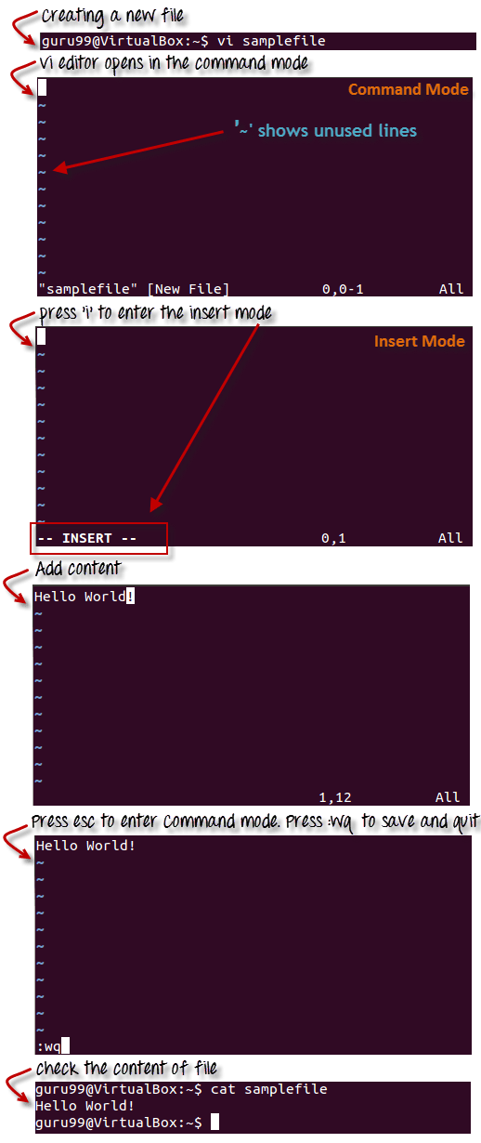
How to use vi editor

Slide 8
VI Editing commands
i - Insert at cursor (goes into insert mode)
a - Write after cursor (goes into insert mode)
A - Write at the end of line (goes into insert mode)
ESC - Terminate insert mode
u - Undo last change
U - Undo all changes to the entire line
o - Open a new line (goes into insert mode)
dd - Delete line

Slide 9
3dd - Delete 3 lines.
D - Delete contents of line after the cursor
C - Delete contents of a line after the cursor and insert new text. Press ESC key to end insertion.
dw - Delete word
4dw - Delete 4 words
cw - Change word
x - Delete character at the cursor
r - Replace character
R - Overwrite characters from cursor onward
s - Substitute one character under cursor continue to insert
S - Substitute entire line and begin to insert at the beginning of the line
~ - Change case of individual character

Slide 10
Moving within a file
k - Move cursor up
j - Move cursor down
h - Move cursor left
l - Move cursor right
You need to be in the command mode to move within a file. The default keys for navigation are mentioned below else; You can also use the arrow keys on the keyboard.
Saving and Closing the file
Shift+zz - Save the file and quit
:w - Save the file but keep it open
:q - Quit without saving
:wq - Save the file and quit
You should be in the command mode to exit the editor and save changes to the file.

Slide 11
What is a Shell?
An Operating is made of many components, but its two prime components are -
-Kernel
-Shell
A Kernel is at the nucleus of a computer. It makes the communication between the hardware and software possible. While the Kernel is the innermost part of an operating system, a shell is the outermost one.
A shell in a Linux operating system takes input from you in the form of commands, processes it, and then gives an output. It is the interface through which a user works on the programs, commands, and scripts. A shell is accessed by a terminal which runs it.
When you run the terminal, the Shell issues a command prompt (usually $), where you can type your input, which is then executed when you hit the Enter key. The output or the result is thereafter displayed on the terminal.

Slide 12
Types of Shell
There are two main shells in Linux:
1. The Bourne Shell: The prompt for this shell is $ and its derivatives are listed below:
POSIX shell also is known as sh
Korn Shell also knew as sh
Bourne Again SHell also knew as bash (most popular)
2. The C shell: The prompt for this shell is %, and its subcategories are:
C shell also is known as csh
Tops C shell also is known as tcsh

Slide 13
What Is Shell Scripting?
SHELL SCRIPTING is writing a series of commands for the shell to execute. It can combine lengthy and repetitive sequences of commands into a single and simple script, which can be stored and executed anytime. This reduces the effort required by the end user.
Steps in creating a Shell Script
Create a file using a vi editor(or any other editor). Name script file with extension .sh
Start the script with #! /bin/sh
Write some code.
Save the script file as filename.sh
For executing the script type bash filename.sh
"#!" is an operator called shebang which directs the script to the interpreter location. So, if we use"#! /bin/sh" the script gets directed to the bourne-shell.

Slide 14
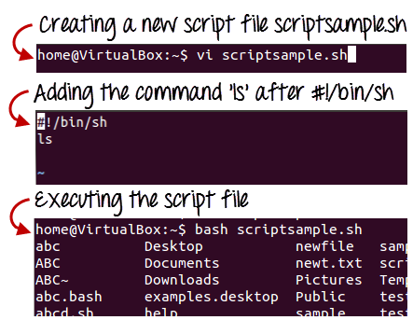
Let's create a small script -
#!/bin/sh ls
Let's see the steps to create it -
Command 'ls' is executed when we execute the scriptsample.sh file.

Slide 15
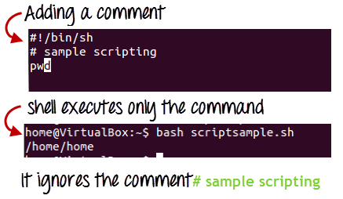
Adding shell comments
Commenting is important in any program. In Shell programming, the syntax to add a comment is
#comment
Let understand this with an example.

Slide 16
What are Shell Variables?
Variables store data in the form of characters and numbers. Similarly, Shell variables are used to
store information and they can by the shell only.
For example, the following creates a shell variable and then prints it:
variable ="Hello"
echo $variable
Below is a small script which will use a variable.
#!/bin/sh
echo "what is your name?“
read name
echo "How do you do, $name?“
read remark
echo "I am $remark too!"
Let's understand, the steps to create and execute the script

Slide 17
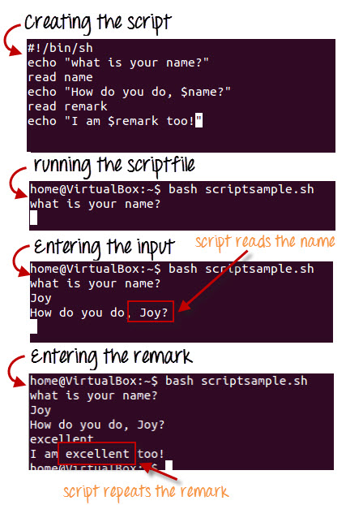
Let's understand, the steps to create and execute the script

Slide 18
These Wildcards Characters
Wildcards (also referred to as meta characters) are symbols or special characters that represent other characters.
wildcards are interpreted by the shell and the results are returned to the command you run. There are three main wildcards in Linux:
An asterisk (*) – matches one or more occurrences of any character, including no character.
Question mark (?) – represents or matches a single occurrence of any character.
Bracketed characters ([ ]) – matches any occurrence of character enclosed in the square brackets.
1. This command matches all files with names starting with l (which is the prefix) and ending with one or more occurrences of any character.
$ ls -l l*

Slide 19
The following command matches all files with names beginning with l followed by any single character and ending with st.sh (which is the suffix).
$ ls l?st.sh
The command below matches all files with names starting with l followed by any of the characters in the square bracket but ending with st.sh.
$ ls l[abdcio]st.sh
This command will match all filenames prefixed with any two characters followed by st but ending with one or more occurrence of any character.
$ ls
$ ls ??st*
This example matches filenames starting with any of these characters [clst] and ending with one or more occurrence of any character.
$ ls
$ ls [clst]*
In this examples, only filenames starting with any of these characters [clst] followed by one of these [io] and then any single character, followed by a t and lastly, one or more occurrence of any character will be listed.
$ ls
$ ls [clst][io]?t*

